Slide 1
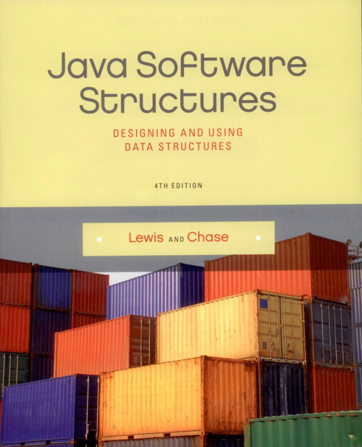
Chapter 6
Lists

Slide 2
Chapter Scope
Types of list collections
Using lists to solve problems
Various list implementations
Comparing list implementations

Slide 3
Lists
A list is a linear collection, like stacks and queues, but is more flexible
Adding and removing elements in lists can occur at either end or anywhere in the middle
We will examine three types of list collections:
ordered lists
unordered lists
indexed lists

Slide 4
Ordered Lists
The elements in an ordered list are ordered by some inherent characteristic of the elements
names in alphabetical order
scores in ascending order
The elements themselves determine where they are stored in the list

Slide 5
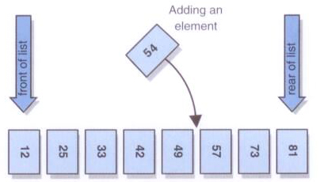
Ordered Lists
An ordered list:

Slide 6
Unordered Lists
There is an order to the elements in an unordered list, but that order is not based on element characteristics
The user of the list determines the order of the elements
A new element can be put on the front or the rear of the list, or it can be inserted after a particular element already in the list

Slide 7
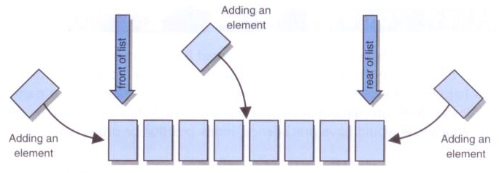
Unordered Lists
An unordered list:

Slide 8
Indexed Lists
In an indexed list, elements are referenced by their numeric position in the list
Like an unordered list, there is no inherent relationship among the elements
The user can determine the order
Every time the list changes, the indexes are updated

Slide 9
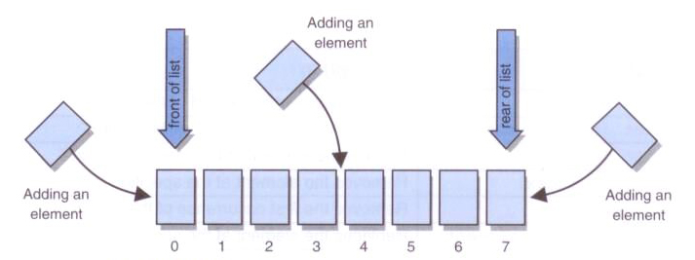
Indexed Lists
An indexed list:

Slide 10
Lists in the Java API
The list classes in the Java API primarily support the concept of an indexed list (and somewhat an unordered list)
The API does not have any classes that directly implement an ordered list
The ArrayList and LinkedList classes both implement the List<E> interface

Slide 11
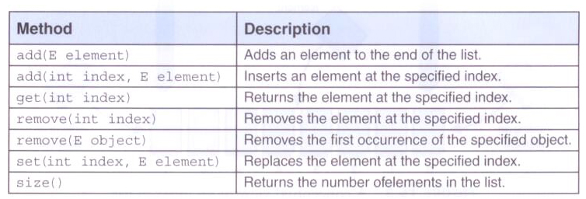
Lists in the Java API
Some of the operations from the List<E> interface:

Slide 12
Program of Study
Let's use an unordered list to manage the courses that a student takes to fulfill degree requirements
The Course class represents a course, which may or may not have already been taken
The ProgramOfStudy course manages a list of Course objects
The list is stored for later use using serialization

Slide 13
import java.io.IOException;
/**
* Demonstrates the use of a list to manage a set of objects.
*
* @author Lewis and Chase
* @version 4.0
*/
public class POSTester
{
/**
* Creates and populates a Program of Study. Then saves it using serialization.
*/
public static void main(String[] args) throws IOException
{
ProgramOfStudy pos = new ProgramOfStudy();
pos.addCourse(new Course("CS", 101, "Introduction to Programming", "A-"));
pos.addCourse(new Course("ARCH", 305, "Building Analysis", "A"));
pos.addCourse(new Course("GER", 210, "Intermediate German"));
pos.addCourse(new Course("CS", 320, "Computer Architecture"));
pos.addCourse(new Course("THE", 201, "The Theatre Experience"));
Course arch = pos.find("CS", 320);
pos.addCourseAfter(arch, new Course("CS", 321, "Operating Systems"));

Slide 14
Course theatre = pos.find("THE", 201);
theatre.setGrade("A-");
Course german = pos.find("GER", 210);
pos.replace(german, new Course("FRE", 110, "Beginning French", "B+"));
System.out.println(pos);
pos.save("ProgramOfStudy");
}
}

Slide 15
import java.io.FileInputStream;
import java.io.FileNotFoundException;
import java.io.FileOutputStream;
import java.io.IOException;
import java.io.ObjectInputStream;
import java.io.ObjectOutputStream;
import java.io.Serializable;
import java.util.Iterator;
import java.util.LinkedList;
import java.util.List;
/**
* Represents a Program of Study, a list of courses taken and planned, for an
* individual student.
*
* @author Lewis and Chase
* @version 4.0
*/
public class ProgramOfStudy implements Iterable<Course>, Serializable
{
private List<Course> list;
/**
* Constructs an initially empty Program of Study.
*/
public ProgramOfStudy()
{
list = new LinkedList<Course>();
}

Slide 16
/**
* Adds the specified course to the end of the course list.
*
* @param course the course to add
*/
public void addCourse(Course course)
{
if (course != null)
list.add(course);
}
/**
* Finds and returns the course matching the specified prefix and number.
*
* @param prefix the prefix of the target course
* @param number the number of the target course
* @return the course, or null if not found
*/
public Course find(String prefix, int number)
{
for (Course course : list)
if (prefix.equals(course.getPrefix()) &&
number == course.getNumber())
return course;
return null;
}

Slide 17
/**
* Adds the specified course after the target course. Does nothing if
* either course is null or if the target is not found.
*
* @param target the course after which the new course will be added
* @param newCourse the course to add
*/
public void addCourseAfter(Course target, Course newCourse)
{
if (target == null || newCourse == null)
return;
int targetIndex = list.indexOf(target);
if (targetIndex != -1)
list.add(targetIndex + 1, newCourse);
}

Slide 18
/**
* Replaces the specified target course with the new course. Does nothing if
* either course is null or if the target is not found.
*
* @param target the course to be replaced
* @param newCourse the new course to add
*/
public void replace(Course target, Course newCourse)
{
if (target == null || newCourse == null)
return;
int targetIndex = list.indexOf(target);
if (targetIndex != -1)
list.set(targetIndex, newCourse);
}
/**
* Creates and returns a string representation of this Program of Study.
*
* @return a string representation of the Program of Study
*/
public String toString()
{
String result = "";
for (Course course : list)
result += course + "\n";
return result;
}

Slide 19
/**
* Returns an iterator for this Program of Study.
*
* @return an iterator for the Program of Study
*/
public Iterator<Course> iterator()
{
return list.iterator();
}
/**
* Saves a serialized version of this Program of Study to the specified
* file name.
*
* @param fileName the file name under which the POS will be stored
* @throws IOException
*/
public void save(String fileName) throws IOException
{
FileOutputStream fos = new FileOutputStream(fileName);
ObjectOutputStream oos = new ObjectOutputStream(fos);
oos.writeObject(this);
oos.flush();
oos.close();
}

Slide 20
/**
* Loads a serialized Program of Study from the specified file.
*
* @param fileName the file from which the POS is read
* @return the loaded Program of Study
* @throws IOException
* @throws ClassNotFoundException
*/
public static ProgramOfStudy load(String fileName) throws IOException, ClassNotFoundException
{
FileInputStream fis = new FileInputStream(fileName);
ObjectInputStream ois = new ObjectInputStream(fis);
ProgramOfStudy pos = (ProgramOfStudy) ois.readObject();
ois.close();
return pos;
}
}

Slide 21
import java.io.Serializable;
/**
* Represents a course that might be taken by a student.
*
* @author Lewis and Chase
* @version 4.0
*/
public class Course implements Serializable
{
private String prefix;
private int number;
private String title;
private String grade;

Slide 22
/**
* Constructs the course with the specified information.
*
* @param prefix the prefix of the course designation
* @param number the number of the course designation
* @param title the title of the course
* @param grade the grade received for the course
*/
public Course(String prefix, int number, String title, String grade)
{
this.prefix = prefix;
this.number = number;
this.title = title;
if (grade == null)
this.grade = "";
else
this.grade = grade;
}
/**
* Constructs the course with the specified information, with no grade
* established.
*
* @param prefix the prefix of the course designation
* @param number the number of the course designation
* @param title the title of the course
*/
public Course(String prefix, int number, String title)
{
this(prefix, number, title, "");
}

Slide 23
/**
* Returns the prefix of the course designation.
*
* @return the prefix of the course designation
*/
public String getPrefix()
{
return prefix;
}
/**
* Returns the number of the course designation.
*
* @return the number of the course designation
*/
public int getNumber()
{
return number;
}
/**
* Returns the title of this course.
*
* @return the prefix of the course
*/
public String getTitle()
{
return title;
}

Slide 24
/**
* Returns the grade for this course.
*
* @return the grade for this course
*/
public String getGrade()
{
return grade;
}
/**
* Sets the grade for this course to the one specified.
*
* @param grade the new grade for the course
*/
public void setGrade(String grade)
{
this.grade = grade;
}
/**
* Returns true if this course has been taken (if a grade has been received).
*
* @return true if this course has been taken and false otherwise
*/
public boolean taken()
{
return !grade.equals("");
}

Slide 25
/**
* Determines if this course is equal to the one specified, based on the
* course designation (prefix and number).
*
* @return true if this course is equal to the parameter
*/
public boolean equals(Object other)
{
boolean result = false;
if (other instanceof Course)
{
Course otherCourse = (Course) other;
if (prefix.equals(otherCourse.getPrefix()) &&
number == otherCourse.getNumber())
result = true;
}
return result;
}
/**
* Creates and returns a string representation of this course.
*
* @return a string representation of the course
*/
public String toString()
{
String result = prefix + " " + number + ": " + title;
if (!grade.equals(""))
result += " [" + grade + "]";
return result;
}
}

Slide 26
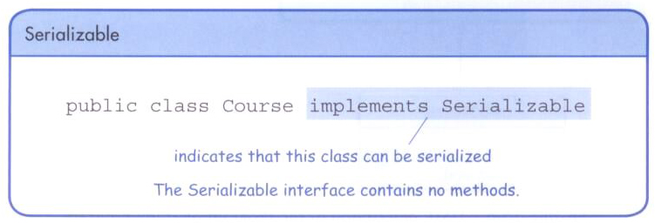
Serialization
Any class whose objects will be saved are tagged with the Serializable interface

Slide 27
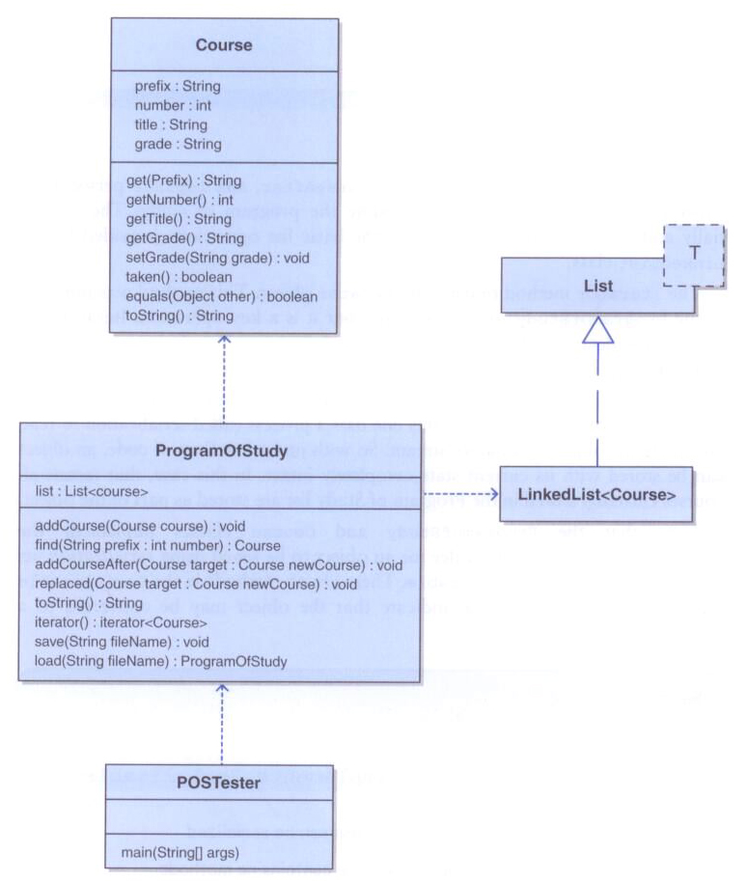
xxx

Slide 28
The Josephus Problem
In a Josephus problem, a set of elements are arranged in a circle
Starting with a particular element, every i^{th} element is removed
Processing continues until there is only one element left
The question: given the starting point and remove count (i), which element is left?

Slide 29
import java.util.*;
/**
* Demonstrates the use of an indexed list to solve the Josephus problem.
*
* @author Lewis and Chase
* @version 4.0
*/
public class Josephus
{
/**
* Continue around the circle eliminating every nth soldier
* until all of the soldiers have been eliminated.
*/
public static void main(String[] args)
{
int numPeople, skip, targetIndex;
List<String> list = new ArrayList<String>();
Scanner in = new Scanner(System.in);
// get the initial number of soldiers
System.out.print("Enter the number of soldiers: ");
numPeople = in.nextInt();
in.nextLine();
// get the number of soldiers to skip
System.out.print("Enter the number of soldiers to skip: ");
skip = in.nextInt();

Slide 30
// load the initial list of soldiers
for (int count = 1; count <= numPeople; count++)
{
list.add("Soldier " + count);
}
targetIndex = skip;
System.out.println("The order is: ");
// Treating the list as circular, remove every nth element
// until the list is empty
while (!list.isEmpty())
{
System.out.println(list.remove(targetIndex));
if (list.size() > 0)
targetIndex = (targetIndex + skip) % list.size();
}
}
}

Slide 31
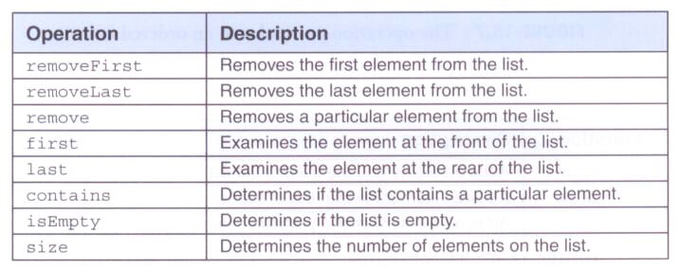
Implementing Lists
Now let's implement our own list collection
The following operations are common to all types of lists:

Slide 32

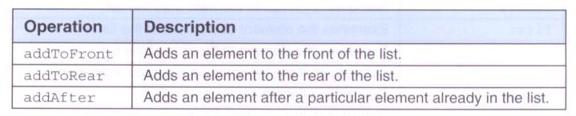
Implementing Lists
Operation particular to an ordered list:
Operations particular to an unordered lists:

Slide 33
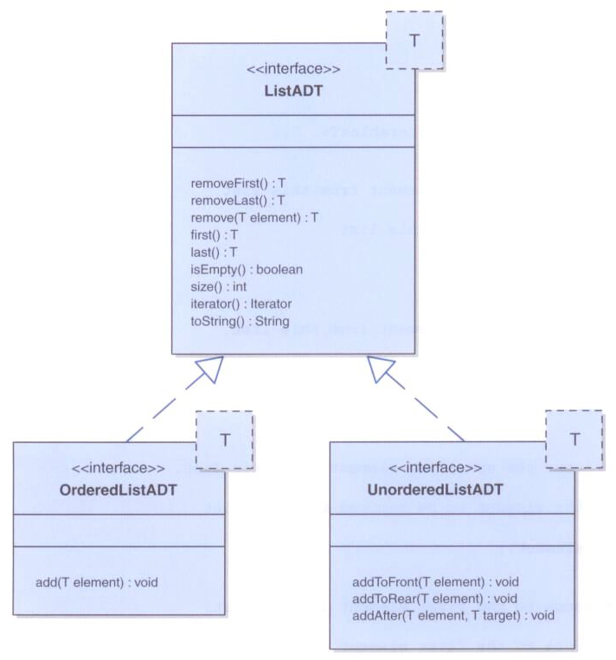
xxx

Slide 34
package jsjf;
import java.util.Iterator;
/**
* ListADT defines the interface to a general list collection. Specific
* types of lists will extend this interface to complete the
* set of necessary operations.
*
* @author Lewis and Chase
* @version 4.0
*/
public interface ListADT<T> extends Iterable<T>
{
/**
* Removes and returns the first element from this list.
*
* @return the first element from this list
*/
public T removeFirst();
/**
* Removes and returns the last element from this list.
*
* @return the last element from this list
*/
public T removeLast();

Slide 35
/**
* Removes and returns the specified element from this list.
*
* @param element the element to be removed from the list
*/
public T remove(T element);
/**
* Returns a reference to the first element in this list.
*
* @return a reference to the first element in this list
*/
public T first();
/**
* Returns a reference to the last element in this list.
*
* @return a reference to the last element in this list
*/
public T last();
/**
* Returns true if this list contains the specified target element.
*
* @param target the target that is being sought in the list
* @return true if the list contains this element
*/
public boolean contains(T target);

Slide 36
/**
* Returns true if this list contains no elements.
*
* @return true if this list contains no elements
*/
public boolean isEmpty();
/**
* Returns the number of elements in this list.
*
* @return the integer representation of number of elements in this list
*/
public int size();
/**
* Returns an iterator for the elements in this list.
*
* @return an iterator over the elements in this list
*/
public Iterator<T> iterator();
/**
* Returns a string representation of this list.
*
* @return a string representation of this list
*/
public String toString();
}

Slide 37
package jsjf;
/**
* OrderedListADT defines the interface to an ordered list collection. Only
* Comparable elements are stored, kept in the order determined by
* the inherent relationship among the elements.
*
* @author Lewis and Chase
* @version 4.0
*/
public interface OrderedListADT<T> extends ListADT<T>
{
/**
* Adds the specified element to this list at the proper location
*
* @param element the element to be added to this list
*/
public void add(T element);
}

Slide 38
package jsjf;
/**
* UnorderedListADT defines the interface to an unordered list collection.
* Elements are stored in any order the user desires.
*
* @author Lewis and Chase
* @version 4.0
*/
public interface UnorderedListADT<T> extends ListADT<T>
{
/**
* Adds the specified element to the front of this list.
*
* @param element the element to be added to the front of this list
*/
public void addToFront(T element);

Slide 39
/**
* Adds the specified element to the rear of this list.
*
* @param element the element to be added to the rear of this list
*/
public void addToRear(T element);
/**
* Adds the specified element after the specified target.
*
* @param element the element to be added after the target
* @param target the target is the item that the element will be added
* after
*/
public void addAfter(T element, T target);
}

Slide 40
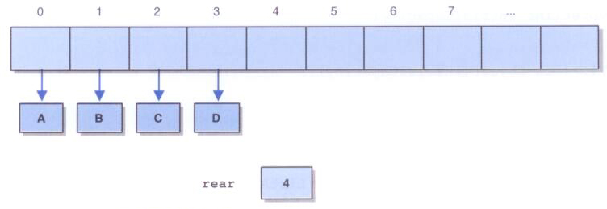
Implementing a List with an Array
Since elements can be added anywhere in the list, shifting elements cannot be avoided
So a straightforward implementation can be adopted:

Slide 41
package jsjf;
import jsjf.exceptions.*;
import java.util.*;
/**
* ArrayList represents an array implementation of a list. The front of
* the list is kept at array index 0. This class will be extended
* to create a specific kind of list.
*
* @author Lewis and Chase
* @version 4.0
*/
public abstract class ArrayList<T> implements ListADT<T>, Iterable<T>
{
private final static int DEFAULT_CAPACITY = 100;
private final static int NOT_FOUND = -1;
protected int rear;
protected T[] list;
protected int modCount;
/**
* Creates an empty list using the default capacity.
*/
public ArrayList()
{
this(DEFAULT_CAPACITY);
}

Slide 42
/**
* Creates an empty list using the specified capacity.
*
* @param initialCapacity the integer value of the size of the array list
*/
public ArrayList(int initialCapacity)
{
rear = 0;
list = (T[])(new Object[initialCapacity]);
modCount = 0;
}

Slide 43
/**
* Removes and returns the specified element.
*
* @param element the element to be removed and returned from the list
* @return the removed elememt
* @throws ElementNotFoundException if the element is not in the list
*/
public T remove(T element)
{
T result;
int index = find(element);
if (index == NOT_FOUND)
throw new ElementNotFoundException("ArrayList");
result = list[index];
rear--;
// shift the appropriate elements
for (int scan=index; scan < rear; scan++)
list[scan] = list[scan+1];
list[rear] = null;
modCount++;
return result;
}

Slide 44
/**
* Returns true if this list contains the specified element.
*
* @param target the target element
* @return true if the target is in the list, false otherwise
*/
public boolean contains(T target)
{
return (find(target) != NOT_FOUND);
}
/**
* Returns the array index of the specified element, or the
* constant NOT_FOUND if it is not found.
*
* @param target the target element
* @return the index of the target element, or the
* NOT_FOUND constant
*/
private int find(T target)
{
int scan = 0;
int result = NOT_FOUND;
if (!isEmpty())
while (result == NOT_FOUND && scan < rear)
if (target.equals(list[scan]))
result = scan;
else
scan++;
return result;
}

Slide 45
/**
* Adds the specified Comparable element to this list, keeping
* the elements in sorted order.
*
* @param element the element to be added to the list
*/
public void add(T element)
{
if (!(element instanceof Comparable))
throw new NonComparableElementException("OrderedList");
Comparable<T> comparableElement = (Comparable<T>)element;
if (size() == list.length)
expandCapacity();
int scan = 0;
// find the insertion location
while (scan < rear && comparableElement.compareTo(list[scan]) > 0)
scan++;
// shift existing elements up one
for (int shift=rear; shift > scan; shift--)
list[shift] = list[shift-1];
// insert element
list[scan] = element;
rear++;
modCount++;
}

Slide 46
/**
* Adds the specified element after the specified target element.
* Throws an ElementNotFoundException if the target is not found.
*
* @param element the element to be added after the target element
* @param target the target that the element is to be added after
*/
public void addAfter(T element, T target)
{
if (size() == list.length)
expandCapacity();
int scan = 0;
// find the insertion point
while (scan < rear && !target.equals(list[scan]))
scan++;
if (scan == rear)
throw new ElementNotFoundException("UnorderedList");
scan++;
// shift elements up one
for (int shift=rear; shift > scan; shift--)
list[shift] = list[shift-1];
// insert element
list[scan] = element;
rear++;
modCount++;
}

Slide 47
Implementing a List with Links
A classic linked list is an obvious choice for implementing a list collection
The LinearNode class introduced earlier is reused here
Both head and tail references are maintained, as well as an integer count

Slide 48
package jsjf;
import jsjf.exceptions.*;
import java.util.*;
/**
* LinkedList represents a linked implementation of a list.
*
* @author Lewis and Chase
* @version 4.0
*/
public abstract class LinkedList<T> implements ListADT<T>, Iterable<T>
{
protected int count;
protected LinearNode<T> head, tail;
protected int modCount;
/**
* Creates an empty list.
*/
public LinkedList()
{
count = 0;
head = tail = null;
modCount = 0;
}

Slide 49
/**
* Removes the first instance of the specified element from this
* list and returns a reference to it. Throws an EmptyCollectionException
* if the list is empty. Throws a ElementNotFoundException if the
* specified element is not found in the list.
*
* @param targetElement the element to be removed from the list
* @return a reference to the removed element
* @throws EmptyCollectionException if the list is empty
* @throws ElementNotFoundException if the target element is not found
*/
public T remove(T targetElement) throws EmptyCollectionException,
ElementNotFoundException
{
if (isEmpty())
throw new EmptyCollectionException("LinkedList");
boolean found = false;
LinearNode<T> previous = null;
LinearNode<T> current = head;
while (current != null && !found)
if (targetElement.equals(current.getElement()))
found = true;
else
{
previous = current;
current = current.getNext();
}

Slide 50
if (!found)
throw new ElementNotFoundException("LinkedList");
if (size() == 1) // only one element in the list
head = tail = null;
else if (current.equals(head)) // target is at the head
head = current.getNext();
else if (current.equals(tail)) // target is at the tail
{
tail = previous;
tail.setNext(null);
}
else // target is in the middle
previous.setNext(current.getNext());
count--;
modCount++;
return current.getElement();
}

